Slide 1
Stacks and Queues
EECS 233

Slide 2
Last Week: Lists
How to represent a sequence of objects? Lists
Data structures:
  Array lists
  Linked lists
Operations or methods:
  Insert
  Remove
  Traversal
  etc

Slide 3
Stack ADT
A stack is a special sequence in which:
  items can be added and removed only at one end (the top)
  you can only access the item that is currently at the top
Operations:
  boolean push(ItemType i); add an item to the top of the stack
  ItemType pop(); remove the item at the top of the stack
  ItemType peek(); get the item at the top of the stack, but don’t remove it
  boolean isEmpty();
  boolean isFull();
The interface provides no way to access/insert/delete an item at an arbitrary position.
  Enforced by encapsulation
push
pop/peek
9
15
8
push(8);
push(15);
push(9);
pop() - returns 9

Slide 4
Array Implementation of Stacks
9
Example: the integer stack would be represented as follows:
15
8
items
8
15
9
stack
top
2
reference
maxSize
1000
ArrayStack

Slide 5
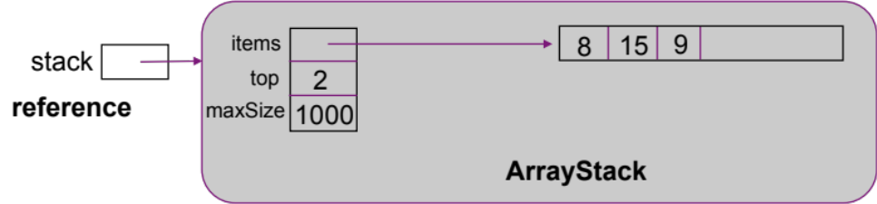
Array Implementation: Constructors and Methods
  public ArrayStack(int max) {
    items = new int[max]; // a stack of integers
    top = -1;
    maxSize = max;
  }
  public boolean isEmpty() {
    return (top == -1);
  }
  public boolean isFull() {
    return (top == maxSize – 1);
  }

Slide 6
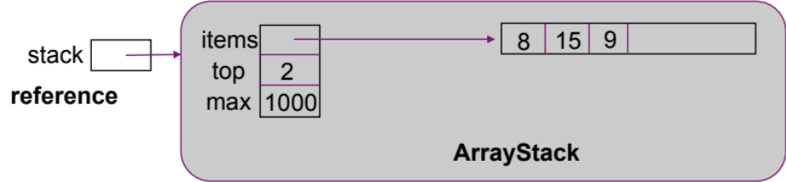
Generic ArrayStack Class
Generic classes use type variables T that serve as placeholders for actual types.
  public class ArrayStack<T> {
    private T[ ] items;
    private int top;
    private int maxSize;
    …
    public boolean push(T item) {
    …
  }
Constructor:
  public ArrayStack(int max) {
    items = (T[ ]) new Object[max];
    top = -1;
    maxSize = max;
  }
Methods: push(), pop(), peek()
  public boolean push(T item) {
    if (isFull())
      return false;
    items[++top] = item;
    return true;
  }
  public T pop() {
    if (isEmpty())
    throw new
    RuntimeException(“Removing
    from empty”);
    return items[top--];
  }
  public T peek() {
    if (isEmpty())
    throw new
    RuntimeException(“Stack is
    empty”);
    return items[top];
  }
Usage:
ArrayStack<Bag> bagStack = new ArrayStack<Bag>(100);

Slide 7
Linked-List Implementation of Stacks
The integer stack in linked list:
9
15
8
9
15
8
stack
top
null
reference
LLStack

Slide 8
Generic LLStack Class
  public class LLStack<T> {
    private class Node {
      T item;
      Node next;
    }
    private Node top;
    ...
    public boolean push(T item) {
      ...
    }
  }

Slide 9
Applications: Checking for Delimiter Balancing
Making sure delimiters (e.g., parentheses, brackets) are balanced:
  push open (i.e., left) delimiters onto a stack
  when you encounter a close (i.e., right) delimiter, pop an item off the stack and see if it matches
  example: 5 * [3 + {(5 + 16 – 2)]
    push “[“; push “{“; push “(“;
    pop “(“ when seeing “)”
    pop “{“ when seeing “]” ???

Slide 10
Applications: Infix to Postfix Conversion
Infix is the standard form in expressions
  a + b * c + ( d * e + f ) * g
Postfix: operator after the operands
  a b c * + d e * f + g * +
How to convert? Compare a*b+c (or ab*c+) and a*b^c (or abc^*)
  If the current symbol is an operand, print it.
  If left “(“, push it.
  If the current symbol is an operator, compare it to the operator at the top (if any). If current operator has higher priority (or stack empty) push it; otherwise, pop and print the top, repeat with the next element that is now on top. Once the bottom of the stack or a left parenthesis shows up, push the current operator.
  If current symbol is right “)”, pop & print everything till left “(“, then pop left “(“.
  At the end of input pop&print everything
a
b
c
*
+
d
e
*
  Print a
  Push +
  Print b
  Push * (since * has higher priority than + on top)
  Print c
  Pop * and print it (since + has lower priority than * on top)
  Pop + and print it (since +’s have same priority, we follow the from-left-to-right rule)
  Push +
  Push (
  Print d
  Push *
  Print e
  Pop * and print it (since + lower priority than * on top)
  …
*
(
*
+

Slide 11
Applications: Methods Calls
The runtime stack in memory is a stack application
Recursion may cause problems (stack overflow)
  Tail recursion: recursive call in the end; can be mechanically eliminated to use iteration
/**
* Print list from current element.
*/
public static <AnyType> void printList ( Iterator<AnyType> itr )
{
if( !itr.hasNext( ) )
return;
System.out.println( itr.next( ) );
printList( itr );
}
/**
* Print list from current element.
*/
public static <AnyType> void printList ( Iterator<AnyType> itr )
{
while( true ) {
if( !itr.hasNext( ) )
return;
System.out.println( itr.next( ) );
}
}

Slide 12
Queue ADT
A queue is a special sequence in which:
  items are added at the rear and removed from the front
    first in, first out (FIFO) (vs. a stack, which is last in, first out)
  we can only access the item that is currently at the front
Operations:
  boolean insert(T item); add an item at the rear of the queue
  T remove(); remove the item at the front of the queue
  T peek(); get the item at the front of the queue, but don’t remove it
  boolean isEmpty(); test if the queue is empty
  boolean isFull(); test if the queue is full
Example: a queue of integers
  Starting state: 12 8
  insert 5: 12 8 5
  remove: get 12, state 8 5
remove/peek
insert

Slide 13
Array Implementation of Generic Queues
Five instance variables:
  T[ ] items; // array of type T (type variable)
  int front; // index of item at front of queue
  int rear; // index of item at rear of queue
  int numItems; // number of items in queue (optional for now)
  int maxSize; // size of the array (optional - see array.length)
front
rear
items
12
8
5
queue
front
1
reference
rear
3
numItems
3
maxSize
1000
ArrayQueue
Problem: what do we do when we reach the end of the array?

Slide 14
Circular Array Implementation
Problem: what do we do when we reach the end of the array?
Solution: a circular array.
  When we reach the end of the array, we wrap around to the beginning.
front
rear
0
1
0
1
0
1
2
2
2
9
9
9
3
3
3
8
rear
8
8
rear
4
4
4
7
5
front
7
5
front
7
5
6
6
6
After 9 insertons
After 7 removals
After 4 insertions

Slide 15
Circular Array: Distinguishing Full From Empty
0
1
rear
0
1
rear
0
1
rear
2
2
2
9
9
front
9
front
3
3
3
8
8
8
7
4
7
4
7
4
front
6
5
6
5
6
5
After 6 more
removals: empty
After 10 more
insetions: full
Previous state
The queue is empty when front “overcomes” rear:
  ((rear + 1) % maxSize) == front
But how to distinguish from a full ArrayQueue?
  we maintain numItems!
  Test for (numItems == maxSize)

Slide 16
Constructors and Methods
  public boolean insert(T item) {
    if (isFull())
      return false;
    rear = (rear + 1) % items.length;
    items[rear] = item;
    numItems++;
    return true;
  }
  public T remove() {
    if (isEmpty())
      throw new RuntimeException(“Removing from empty queue”);
    T removed = items[front];
    front = (front + 1) % items.length;
    numItems--;
    return removed;
  }
  public ArrayQueue<T>(int max) {
    items = (T[ ]) new Object[max];
    maxSize = max;
    front = 0;
    rear = -1;
    numItems = 0;
  }
items
0
1
rear
queue
2
front
7
9
reference
rear
2
3
8
numItems
6
7
4
maxSize
10
front
6
5
ArrayQueue

Slide 17
Linked-List Implementation of Queues
Two instance variables:
  Node front; // front of the queue
  Node rear; // rear of the queue
No capacity issue: no need for circular buffer.
9
15
8
queue
front
null
reference
rear
LLQueue

Slide 18
Applications of Queues
First-in first-out (FIFO) inventory control
OS scheduling: processes, print jobs, packets, etc.
Simulations of banks, supermarkets, airports, etc.
Breadth-first traversal of a graph (stay tuned…)

Slide 19
Summary: Efficiency of Stacks and Queues
Stack and Queue complexity
Array and linked list implementation
  Running time of insert (push), remove (pop), peek
  Space complexity?
Mind twister problem: emulate a queue using stacks

